Slide 1
OverVIEW OF NetBeans
Prof. Ronak Sheth

Slide 2
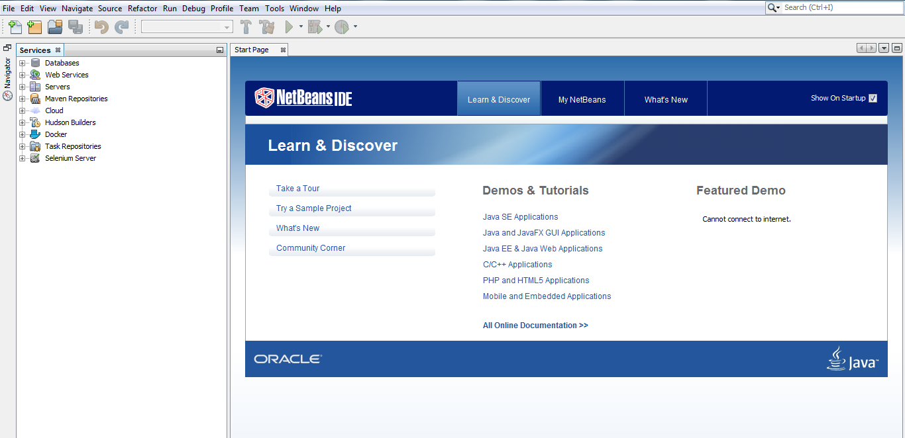
OPEN NetBEans IDE

Slide 3
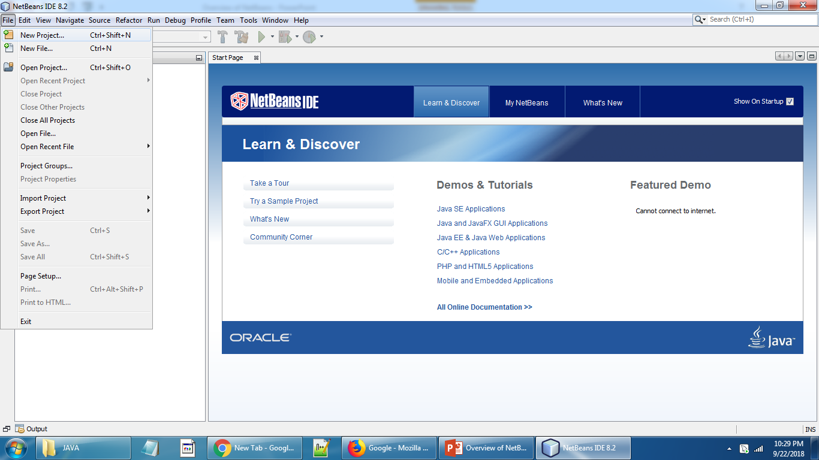
To Create a New Project Click on File →New Project

Slide 4
To Create a New Project Click on File →New Project

Slide 5
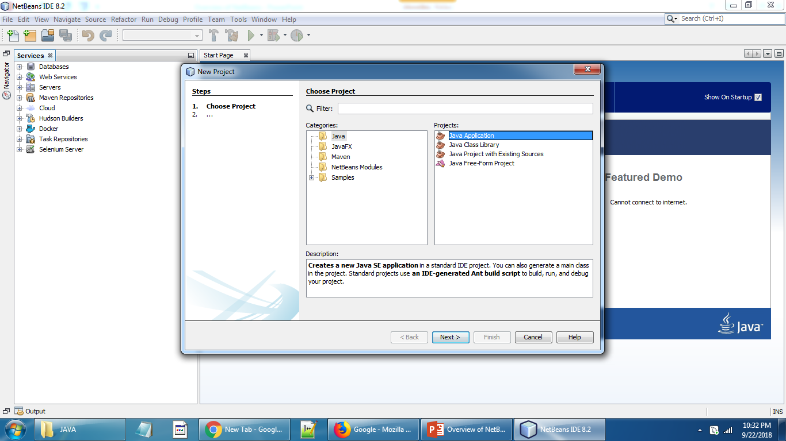
Select Java Application and click next

Slide 6
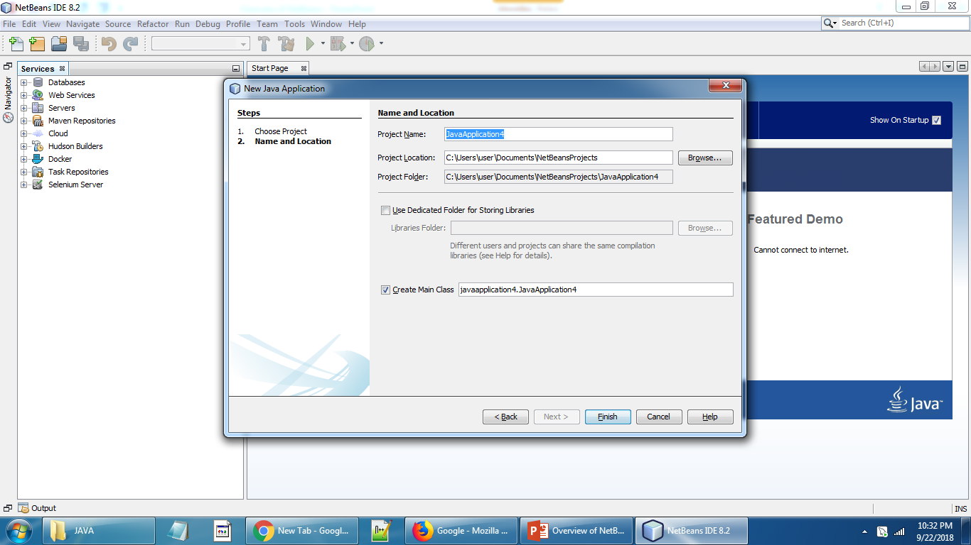
This will show physical location of the project→Click FINISH

Slide 7
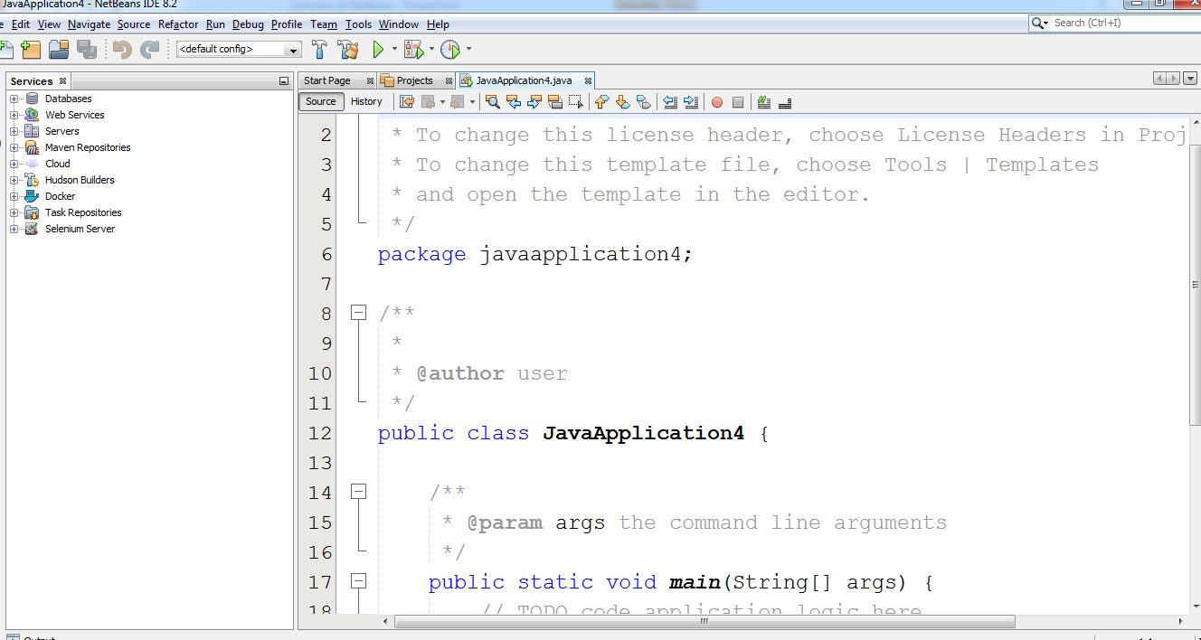
.java file has been created.

Slide 8
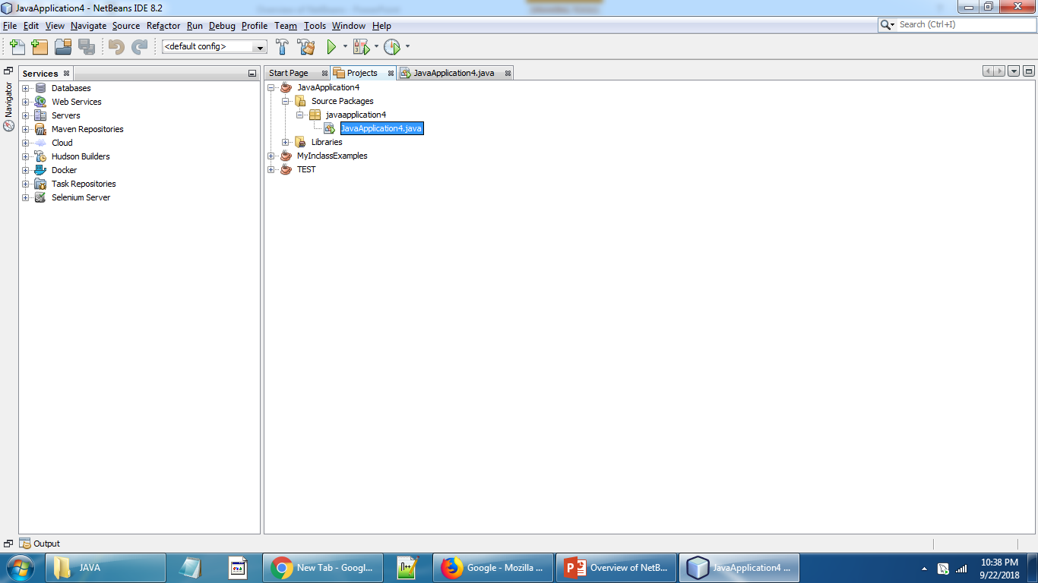
CLICK ON PROJECT TAB

Slide 9
SOURCE PACKAGES folder will have your project folder and .java file.
IMP : Look at the hierarchy: The project which have created has now source package folder: Under this source package ,you can create your own packages.
In simple language, Java packages are nothing but logical segregation of .java files. Each package will contain related .java file.

Slide 10
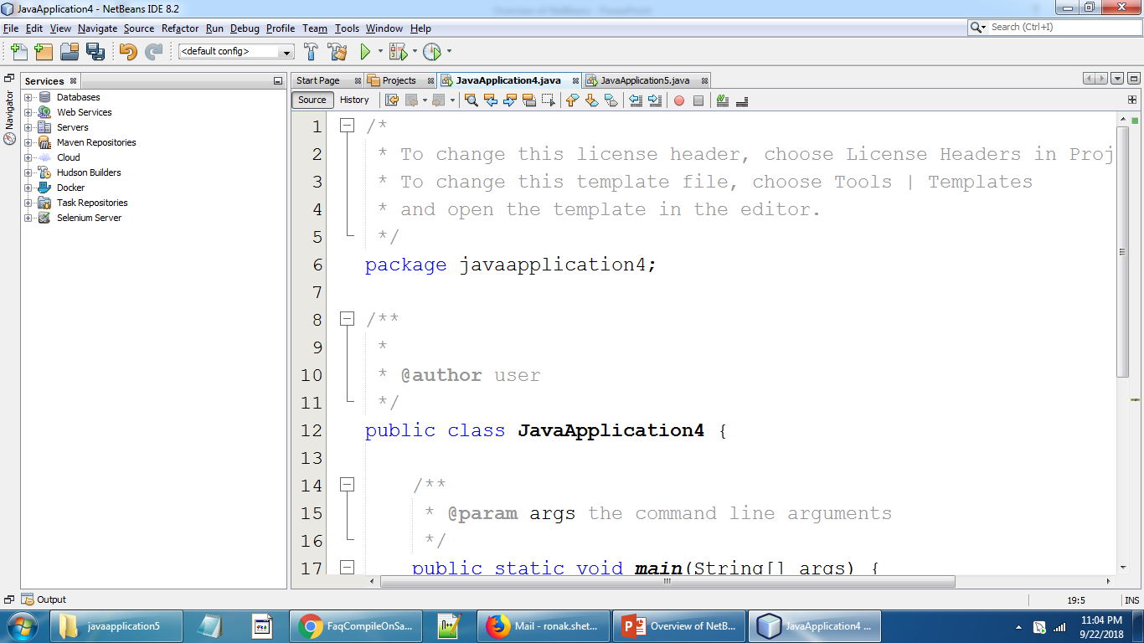
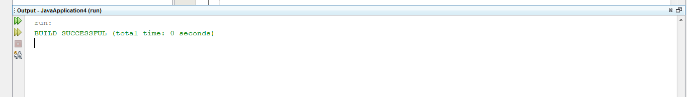

To COMPILE(BUILD) and RUN: SIMPLY CLICK ON green Button OR RUN→RUN PROJECT
Here is the OUTPUT

Slide 11
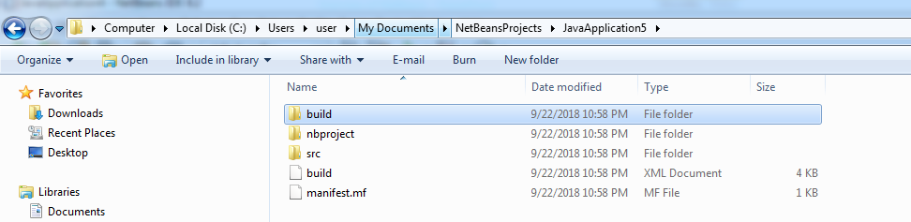
COMPILE(BUILD) Means :It CREATES .class file RUN MEANS: It EXECUTES .class file
Now lets examine physical location of the file.
If you closely observe the physical location of project, there is a build folder. In build folder your class file will be stored under your project name

Slide 12
COMPILE ON SAVE FEATURE in NETBEANS
Files are automatically compiles(i.e .class file has been updated) when you save them
You do not have to compile(build) explicitely.

Slide 13
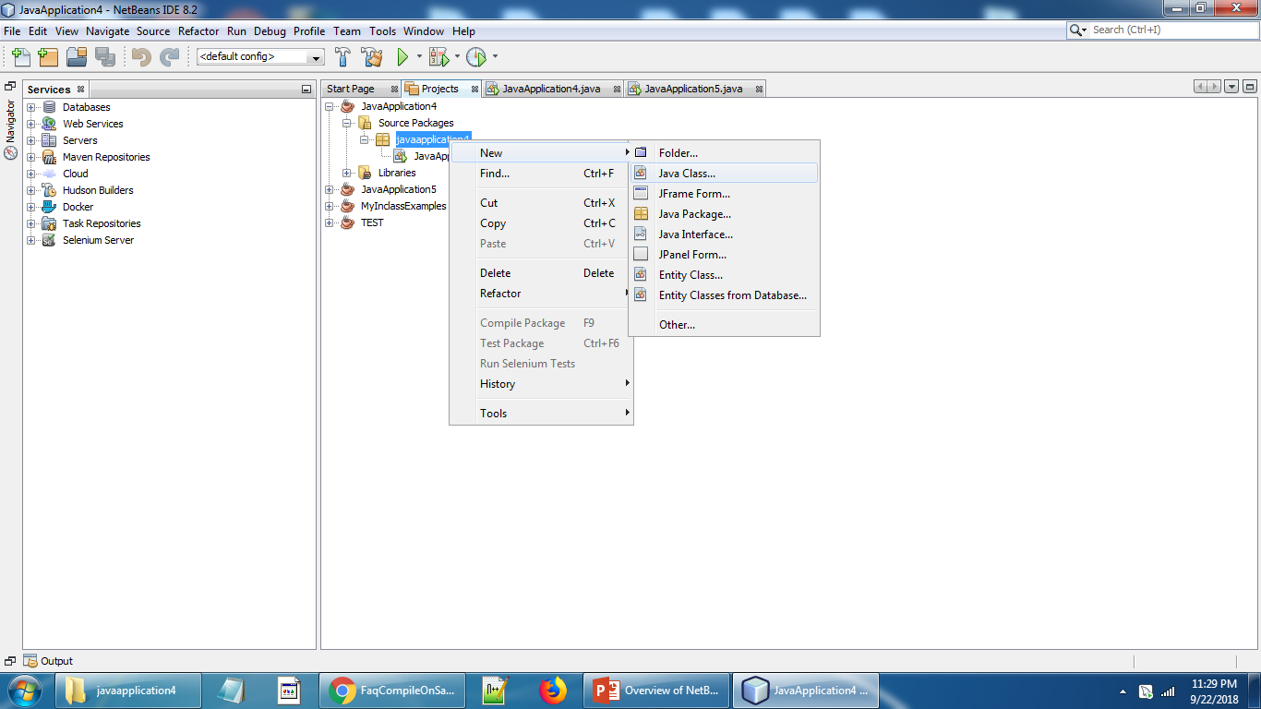
To add more classes to same Package
Go to Project tab→right click→ new →Javaclass
Now lets go and explore java program step by step. Please refer Java programming Basics PPT.

